Slide 1
Fermi-Dirac distribution function
We recall
and
which holds for interaction free fermions and bosons
with the only obvious difference:
fermions
bosons

Slide 2
Fermions
Fermi-Dirac distribution function

Slide 3
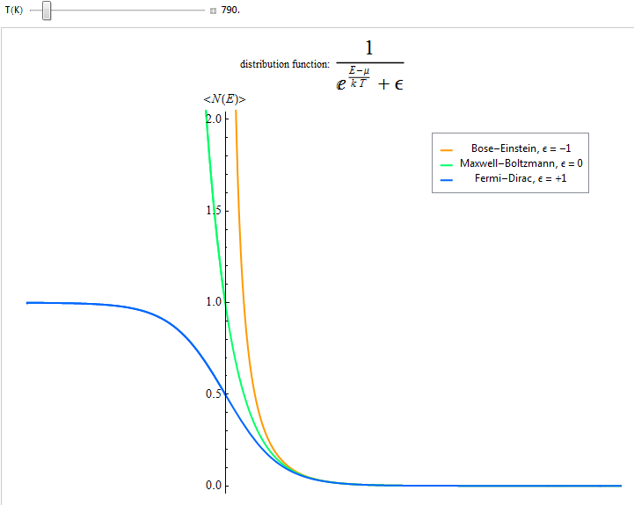
Visualizing & discussing the Fermi-Dirac distribution function
Click here for on-line animation and downloadable live version& source code in Mathematica
Note these are energies of the single
particle energy spectrum we call ε
Fermi energy
It determines the limit of the occupation of the single particle spectrum
ε₀
ε₁
ε₂
…
ε
empty

Slide 4
What determines the T-dependence of the Fermi energy?
The classical limit
Boltzmann distribution

